Slide 1
Marketing 101 And beyond
Refrigerators to Eskimos, Anyone?

Slide 2
Basic Marketing
Tell people that you have a business:
1. Identify the business: Name , address, telephone number, internet site, mobile telephone, etc.
2. Define the products and/or services your business has to offer, and at what price
3. Who to tell: who is your primary or first market?
4. How will you contact your markets?
5. Who else is doing what you want to do? Can you use their experience?

Slide 3
Basic Marketing
The “Marketing Mix”:
Product
Price
Promotion
Place

Slide 4
Basic Marketing “Utility” = Usefulness
Form Utility = Production
Place Utility = Place where the customers will buy the product
Time Utility = Making product available when customers want it
Possession Utility = Once purchased, the product may be used as customer sees fit

Slide 5
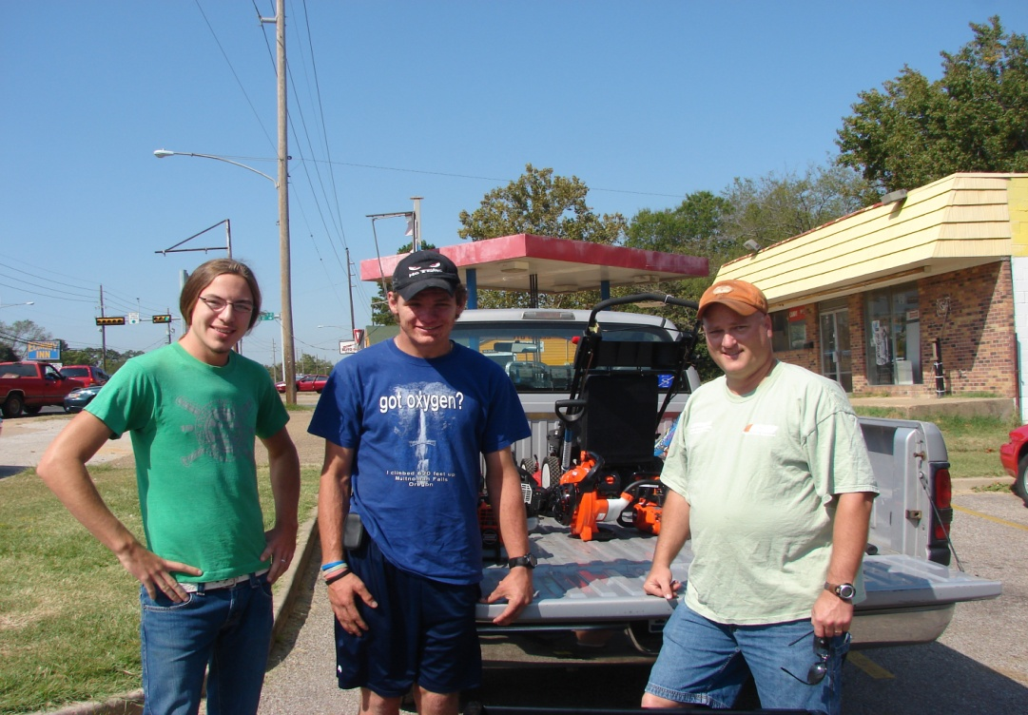
Basic Marketing Emphasize the Difference
What makes your business product or service different?
What makes you different?

Slide 6
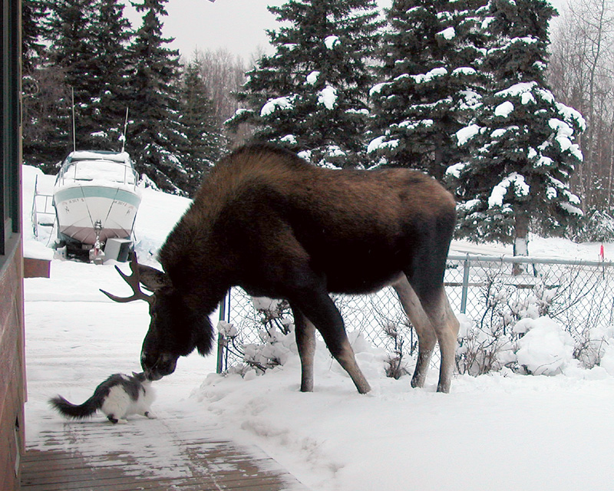
Basic Marketing Strategy #1: Word of Mouth
Based upon customer loyalty and willingness to endorse you
Great customer service=great word of mouth marketing!

Slide 7
Basic Marketing Strategy #2: Business Cards
Basic identification
Business name & logo
Business purpose
Business contact information
Short and simple, but expected by your customers

Slide 8
Basic Marketing Strategy #3: Flyers & Brochures
To inform and educate prospective customers about your product or service
May be useful depending upon the product or service offered and the cost of the materials
Used as a follow up to initial contact with customer to expand customer knowledge and highlight customer service

Slide 9
Basic Marketing Strategy #4: Video Resume/Brochure
May be used to present product or service in “real time”
Shows activities, operations, and results of using the product or service
Promotes familiarity with owner/operator of the business

Slide 10
Basic Marketing Strategy #5: Customer Service as Marketing
Happy customers are the best marketers!
They will introduce you to their friends!
And get you MORE BUSINESS!!

Slide 11
Advertising and sales: What Makes Sense for You?
How much will you have to spend?
What type of advertising makes sense?
Newspaper?
Radio?
Brochures?
Yellow pages?

Slide 12
Advertising and Sales Price & Income
Advertising must get enough sales/income to make the cost worth it
Features and benefits of products and advertising

